Slide 1
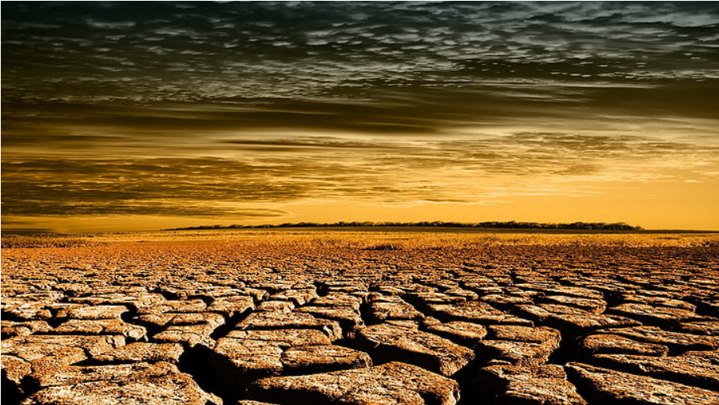
Visualizing Geospatial Data
Notes:
Welcome!! And Thank you for this opportunity to present a topic that might not be directly related to what we are doing here but is universal in its theme in the Data Science realm as it is exploratory in nature.
I am presenting today as an explorer of the groundwater situation in drought ravaged California.
This exploration is part of my upcoming milestone and I am excited to share some of my learning of the domain and the exploratory data analysis tools that I employed.
Ideas and information are free and open but please do not shrare this presentation in any form since this milestone is a work in progress due in Sept and Oct

Slide 2

TABLE OF CONTENTS
INTRO
01
02
03
04
Project
Geopandas Ecosystem
Points and Polygons
Visualization
Inspiration
What we hope to achieve
Purpose of EDA
Geopandas
Folium
Altair
Geodataframes contrasted with Dataframes
Precipitation Dataset
Crops dataset
CRS
Visualization tools
Normalization and proportions
Interactivity
Voronoi diagrams

Slide 3



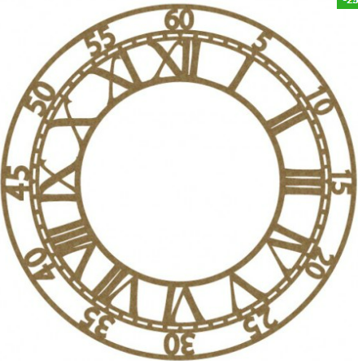



Simi Talkar
Analytics Consultant for Skypoint-CSGPro
Final year of Master of Applied Data Science
Notes:
Our project involves groundwater shortage in California. The agricultural belt – San Joaquin valley lucrative crops
Domestic and agricultural wells are fed by this groundwater.
grapes, tomatoes, hay, sugar beets, nuts, cotton and a multitude of other fruits and vegetables.
The number of features that impact groundwater : Precipitation, Drought, Reservoir, Crops, vegetation, population- Domestic, agricultural Industrial use
Has anybody seen this series? Grim picture of the not so distant future.
We were inspired by the movie a sci-fi series that gives us a peek into the future where water is our currency.
The main protagonist is a man whose daughter is losing her legs and her survival depends on getting more water and he want to increase the threshold on his card.
Inclusive color scheme not westerncentric.

Slide 4

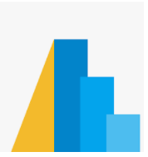


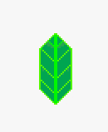
THE RIGHT TOOL FOR THE RIGHT JOB
Geopandas Ecosystem
Python
Altair
Pandas
Geopandas
Folium
Fiona
Shapely
Notes:
Geopandas is a wrapper around Pandas and all the vectorized functions of pandas will be available and so the learning curve is short. Since you are working with familiar dataframes

Slide 5
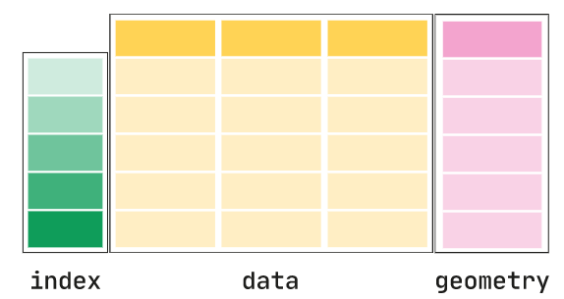
AN INTRO TO GEOPANDAS
Can I use Pandas instead?
GeoPandas, extends the popular data science library pandas by adding support for geospatial data.
pandas.DataFrame
Geopandas.GeoDataFrame
+ geometry columns + spatial operations
pandas.Series
Geopandas.GeoSeries
Notes:
By adding a geometer column you have added a capability to perform spatial operations.
Can you guess some:
Area , closest, nearest.
Only one GeoSeries in a GeoDataFrame is considered the active geometry, which means that all geometric operations applied to a GeoDataFrame operate on this active column. Each GeoSeries can contain any geometry type (you can even mix them within a single array) and has a GeoSeries.crs attribute, df.crs (CRS stands for Coordinate Reference System).

Slide 6
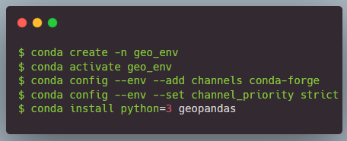
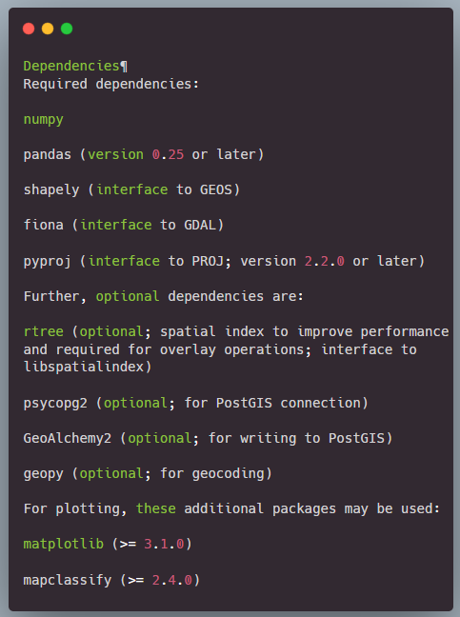
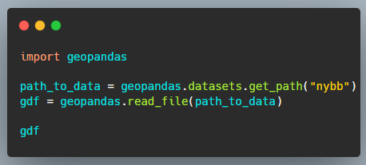
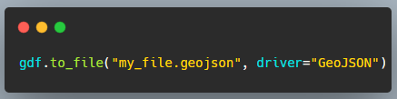
DEPENDENCIES AND INSTALLATION
Notes:
Point out rtree and fiona and the versions of each that are needed and why creating a clean environment and setting it up as shown in documentation is the best option. Point out reading and writing files after installation With Fiona's help, it can read Driver: geojson, shape files It can read zip, urls It can read specific Layers from multilayered files

Slide 7
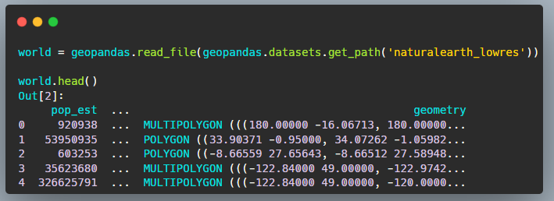
PROJECTIONS
Latitude, Longitude, Township, Ranges, Tracts and Blocks….. Where in the world am I???
EPSG
Coordinate Reference System
Basic classes of geometric objects
EPSG stands for European Petroleum Survey Group. They publish a database of coordinate system information plus some very good related documents on map projections and datums.
The geometric shapes in a GeoSeries or GeoDataFrame object are simply a collection of coordinates in an arbitrary space. A CRS tells Python how those coordinates relate to places on the Earth.
Points / Multi-Points (Well location from latitude-longitude)
Lines / Multi-Lines
Polygons / Multi-Polygons (State of Hawaii)
Notes:
The same CRS can often be referred to in many ways. For example, one of the most commonly used CRS is the WGS84 latitude-longitude projection. This can be referred to using the authority code "EPSG:4326". You can find the codes for most commonly used projections from www.spatialreference.org. geopandas can accept anything accepted by pyproj.CRS.from_user_input(): CRS WKT string (Well Known Text) An authority string (i.e. “epsg:4326”) An EPSG integer code (i.e. 4326) Examples: my_geoseries = my_geoseries.set_crs("EPSG:4326") my_geoseries = my_geoseries.set_crs(epsg=4326)

Slide 8
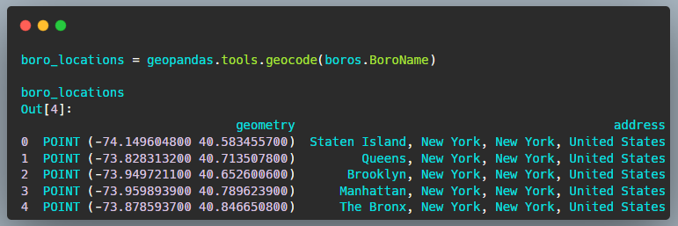
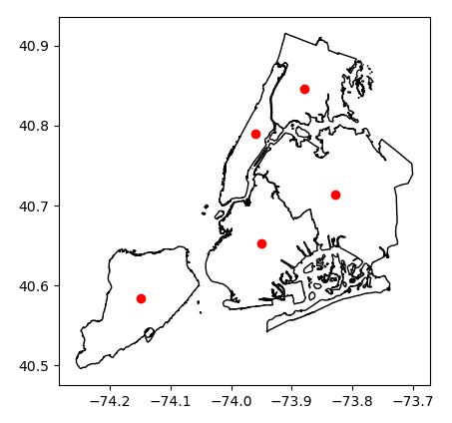
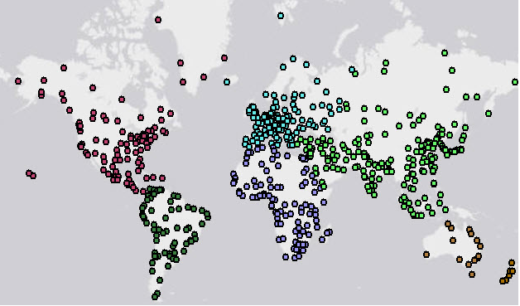
GEOMETRIES
Points, multi-points, polygons, multi-polugons
Points
Multi-Points

Slide 9

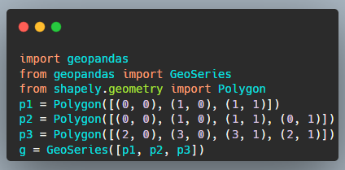
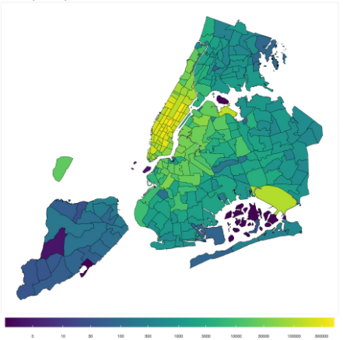
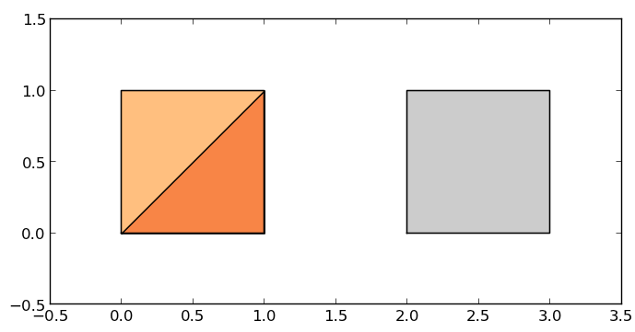
GEOMETRIES (contd.)
Points, multi-points, polygons, multi-polygons
Polygon
Multi-Polygon

Slide 10
MERGE WITH QUALITATIVE DATA
Attribute Joins |  |  | Spatial Joins
Accomplished using the “merge” method |  |  | Two geometry objects are merged based on their “spatial” relationship to one another.
Recommended to use the method called from the spatial dataset |  |  | How: left right , inner
If a Pandas Dataframe is in the left arguments and a Geodataframe is in the right position, the result will no longer be a GeoDataFrame |  |  | Predicate: intersects, contains, within, touches, crosses, overlaps
country_shapes = country_shapes.merge(country_names, on='iso_a3') |  |  | cities_with_country = cities.sjoin(countries, how="inner", predicate='intersects')

Slide 11
MERGE WITH QUALITATIVE DATA
Spatial Joins (Contains) |  |  | Spatial join (Overlays)
We will be joining datasets with information on precipitation, reservoir capacity and other features based on TownshipRange. |  |  | We have available to us tracts and blocks of geometry where crops and vegetation grow.
These datasets capture station location by latitude and longitude. |  |  | These tracts and blocks do not map to the TownshipRange polygons.
We convert the latitude and longitude to points using geopandas points_from_xy() to set it as a geometry. |  |  | So we overlay the geometry of the tracts and blocks as obtained from shape files with the geometry of the area we are interested in at the TownshipRange granularity and compute the common area.
Finally we spatially join the points with a PLSS dataframe that has geometry linked to TownshipRange |  |  | This gets us the percentage of crop and vegetation cover.
Notes:
ownship Range Section TRS The __Township, Range and Section__ or __TRS__ boundaries is a United States public land survey system. The basic unit of the system is the _Section_, a square piece of land one mile by one mile containing 640 acres. 36 sections arranged in a 6 by 6 square make a Township. Where as tracts and blocks are census measurements. A block group is a subdivision of a census tract and contains a cluster of blocks. Block groups usually have between 250 and 550 housing units. A census block is the smallest geographic census unit.

Slide 12

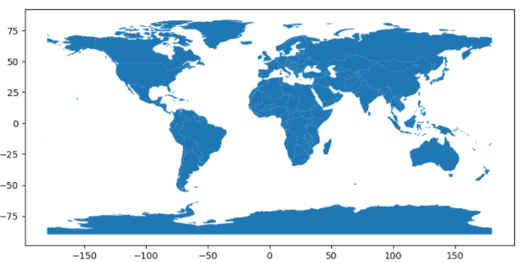
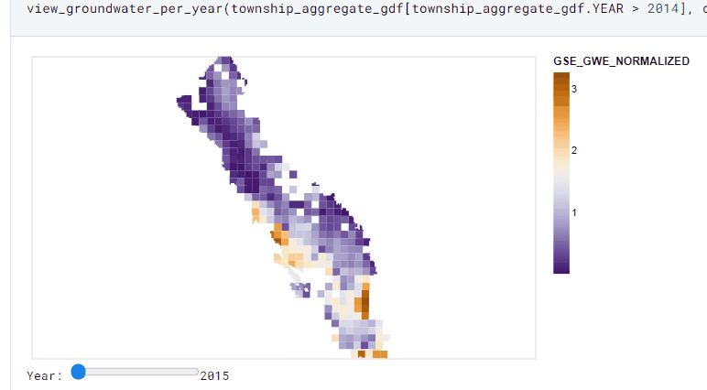
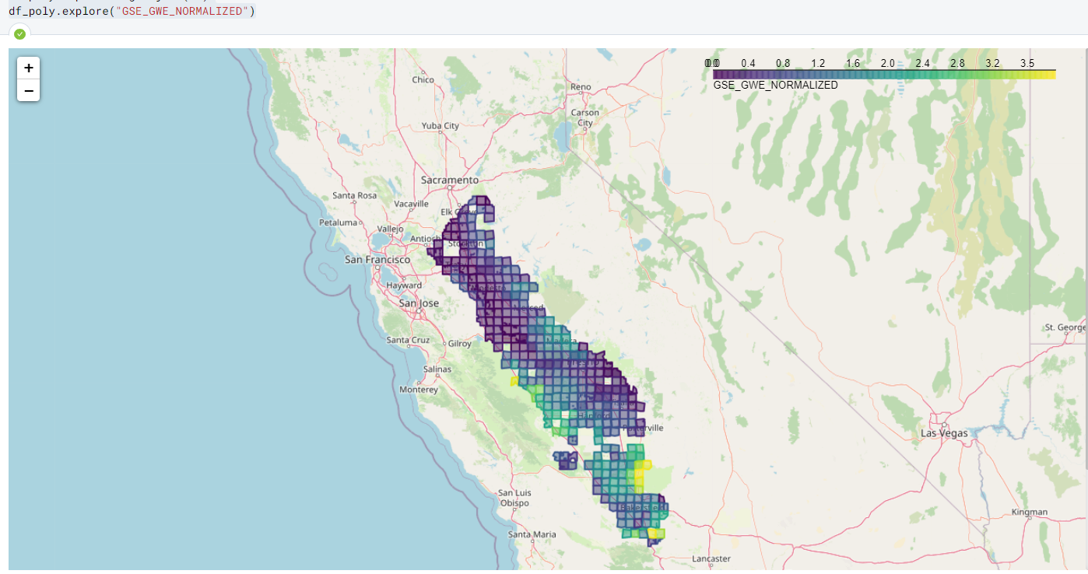
VISUALIZATION
Plotting the geodataframe
Geopandas
GeoPandas objects can plot themselves!!
Backend in Matplotlib (fig, axis)
Layering
Colormaps
world.plot()
Altair
To plot the dataframe using the grammar of graphics by selecting a “mark_geoshape” and encoding values by position, length, scale, and color. It also allow for interactivity, inherently. It allow for layering.
Folium
Moving a step forward with “Tiles”. Adds features of Zoom and scale and more real world plotting. gdf.explore()
.

Slide 13
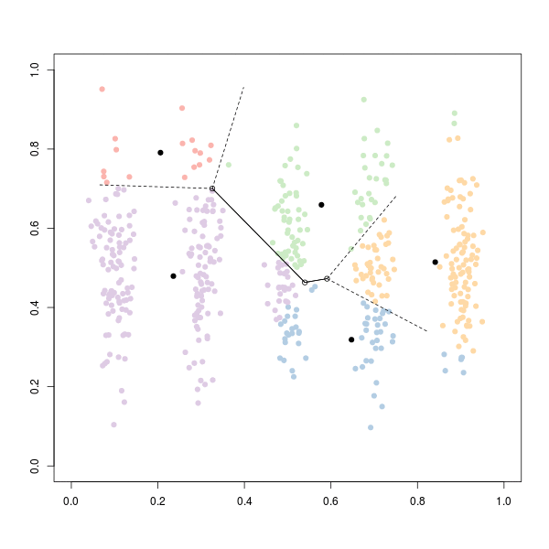
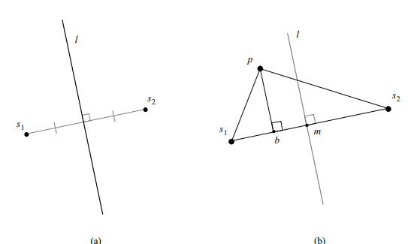
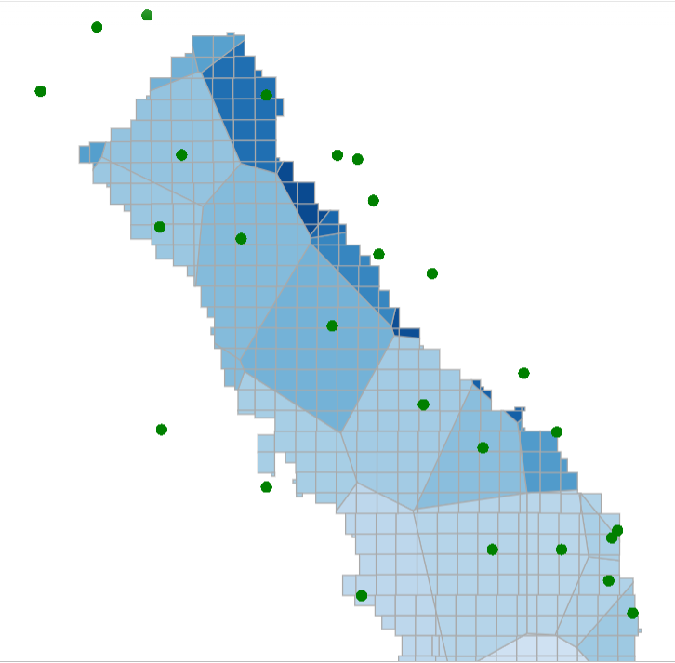
VORONOI DIAGRAMS
Thiessen polygons and K Means Clustering
Purpose
The Voronoi diagram is named after Georgy Voronoy, Voronoi cells are also known as Thiessen polygons. A Voronoi diagram is a collection of polygons with all the points on a plane that is closest to the single object.
For example, it can be used to determine which school is nearest, a given point in a neighborhood, or which cell tower is closest to my cell phone to make a phone call.
Computation
Perpendicular Bisector : We start by joining each pair of vertices by a line. We then draw the perpendicular
bisectors to each of these lines. These three bisectors must intersect, since any three points in the plane define a circle. We then remove the portions of each line beyond the intersection and the diagram is complete. The point where the three rays intersect belongs to the Voronoi
regions for all three points. K-means uses this principle, as well since we want to partition the space of our observations into k classes. each observation belongs to the cluster with the nearest mean.
Our usage We used Voronoi diagrams to create areas into which a precipitation station or reservoir’s data can be diffused. In the file lib\wsdatasets.py the function Voronoi_diagram from shapely package is used to create areas covered by precipitation and reservoir stations.
.

Slide 14
Thank You

